Slide 1
APBD + Petisi
Concept Documentationedwin@suitmedia.com dodo@suitmedia.com wico@suitmedia.com

Slide 2
Project Overview
APBD + Petisi

Slide 3
Problem
Pemerintah DKI Jakarta merilis API terhadap data mereka terkait APBD, trayek angkot, dan rute busway. Mereka merilis data ini dnegan tujuan ada aplikasi yang dapat mengedukasi publik tentang program kerja yang ada di Jakarta. Pemerintah DKI Jakarta ingin warga Jakarta itu dapat mengontrol dan memberi saran terhadap program kerja DKI Jakarta. Selain itu, pemerintah DKI Jakarta juga berharap adanya sistem terpadu mengenai tranportasi umum untuk DKI Jakarta.

Slide 4
Existing System
Not very informative and the experience is bad. http://www.jakarta.go.id/web/apbd. Then, there is no platform that could let people send their petitions or ideas to the state government publicly. https://lapor.ukp.go.id/ is not very effective for new ideas as the web is designed for complaints.

Slide 5
Our Solution
APBD + Petisi

Slide 6
Solution
APBD dashboard and public petition application. Of course, it will be responsive to tackle the mobile users. The application will be the integration of those two features. So, in this application, the user could see and vote on all DKI Jakarta programs and send their suggestions and complains through the petition management.

Slide 7
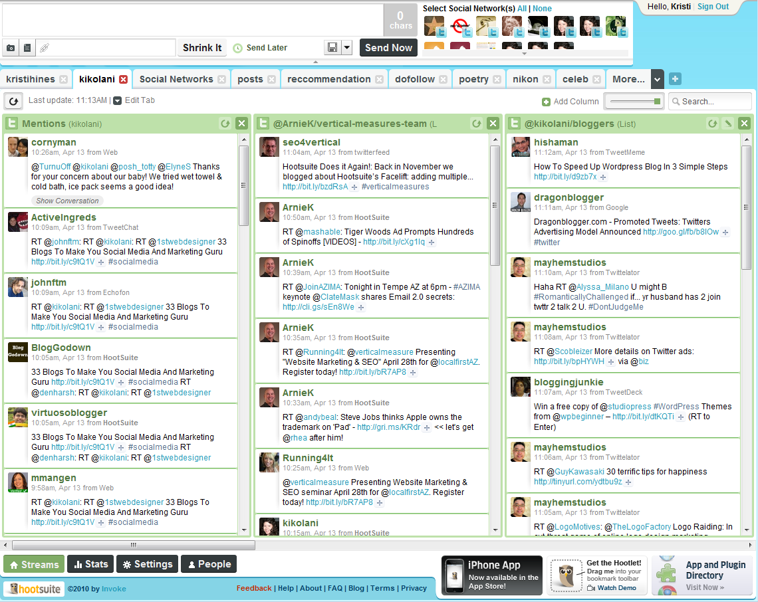
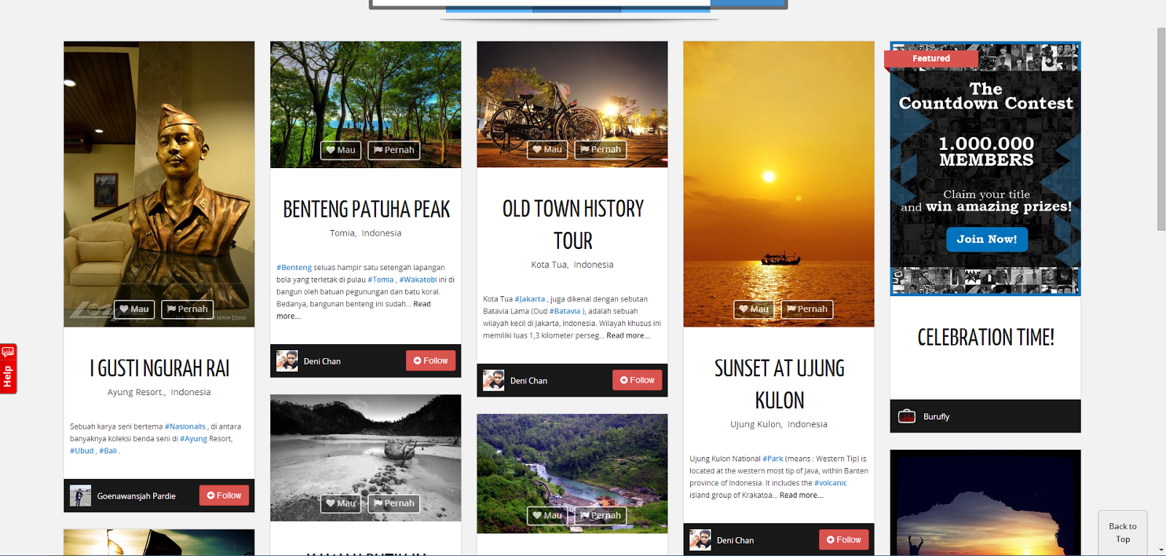
APBD Dashboard
APBD dashboard is like your regular social media dashboard e.g. hootsuite.com or tweetdeck.com but for DKI Jakarta programs. The design will be like those dashboard app. There will be column-based information, but the design will be like burufly.com. Pinterest style.

Slide 8
APBD Dashboard (2)
The point of this feature is to let people know the state government programs and to let them choose their favourite program. Each people could sign up for the website and log in to cast their vote for each program. There will be only two button, like and dislike. User can also comment about the programs to discuss it. It will give a lot of inputs to the state government.

Slide 9
Petition
The second feature is petition management. Almost all state government in the U.S. has this and it really works. So, basically, people could send their ideas and it could be accessed publicly. Then, every people could gave their support by sign the petition. e.g. https://petitions.whitehouse.gov/(the formal one) and http://help.hipchat.com/forums/138883-suggestions-issues(the developer style). The purpose of this feature is to let the state government get a lot of fresh ideas from the people.

Slide 10
Technology
Item | Choice
Frontend Library | JQuery 1.9.x
Web Framework | Laravel 4.1.x
ORM Library | Native
Programming Language | PHP 5.5
Web Server | Nginx
Database Server | MySQL
Load Balancer | Nginx
Operating System | Ubuntu Server

Slide 11
Team
Wico Chandra, Lead developer (wico@suitmedia.com)
Georgius Rinaldo, Front-end developer (dodo@suitmedia.com)
Edwin Lunando, Pro-DotA Player (edwin@suitmedia.com)

Slide 12
Thank You
edwin@suitmedia.com dodo@suitmedia.com wico@suitmedia.com

